Slide 1



Arithmetic Calculator
Dev – Android – Java
QA Automation – Appium
Team:
Victor Ionescu – Dev – .Net – Cancatuzino
Mihai Constantin – QA Automation – Regus
Bogdan Demetrescu – QA Automation - Regus

Slide 2
Applied Technologies:
Cristinel, Stefan, Cornel,
Android studio – IDE for Android Development
Java – programming language used in Android native / hybrid apps
MVP – Model View Presenter - the Presenter contains the UI business logic for the View. All invocations from the View delegate directly to Presenter. The Presenter is also decoupled directly from the View and talks to it through an interface.
Gradle – is an open-source build automation system that builds upon the concepts of Apache Ant and Apache Maven and introduces a Groovy-based domain-specific language (DSL) instead of the XML form used by Apache Maven for declaring the project configuration. Gradle uses a directed acyclic graph ("DAG") to determine the order in which tasks can be run
Toothpick – is a dependency injector which helps passing dependencies to other objects or framework. By injecting dependencies the testing can be done easier and it can be done through constructor.
Butterknife – It allows developers to perform injection on arbitrary objects, views and OnClickListeners so they can focus on writing useful code. Consider Android Butter Knife a reduction library

Slide 3
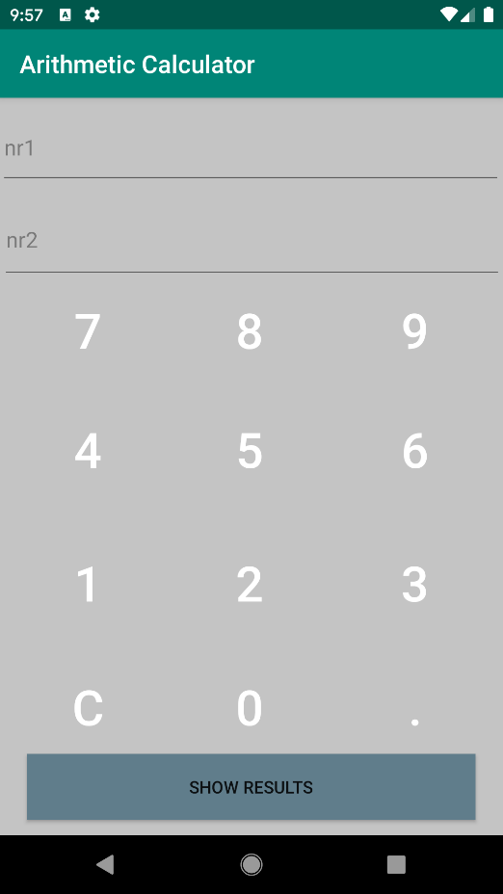
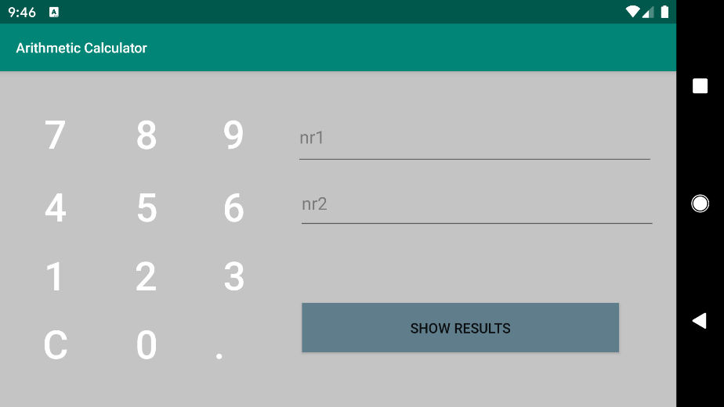
Application Body:
Main Activity: Main Body

Slide 4
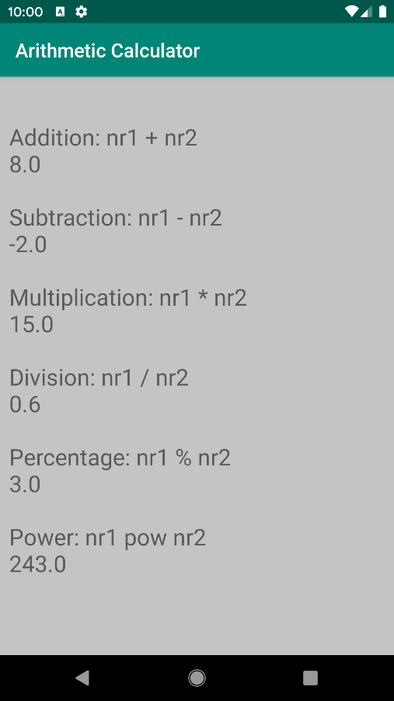
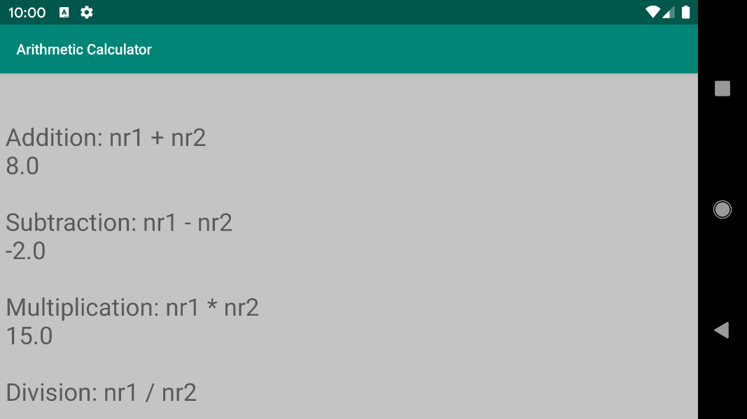
Application Body:
Second Activity: Results Body

Slide 5
Planning phases:
It started from the desire to learn a new technology
Decided on a task we felt comfortable to work on
Started with a Demo App
Decided on a design pattern – suitable for Android
Research for technologies to apply

Slide 6
Time assumption:
Daily time: 2 h
Learning technologies: 2h/ individual
Technology implementation: 2h/ individual
Impediments: 2h/ individual
First screen: 2 days
Second screen: 2h
Overall: 6 days

Slide 7
Team
Efforts
Achievements
Free time investment
Using newly learned technologies
Understanding each team member resolve
and decide on the best approach
To work in self a organized team
The capability to work as one on a task without conflicts
To manage internal relations and take each other into consideration
To understand what are the key points under a deadline
and what can be done to deliver a product on which we are responsible for

Slide 8
Future implementations:
Integrate a fully working QA Automation framework using a webdriver based tool named Appium
Cross-Platform run the app under an iOS emulator.
Implementation of decimal and negative numbers.
Adding an icon for the application.
Adding a log / history button.

Slide 9
Thank you!

